Slide 1

B.TECH CSE • FINAL YEAR PROJECT
InterviewAce
AI
AI Mock Interview Platform
Practice. Analyze. Improve.
Team Members:
Ashirwad Srivastava(230029013055)
Anushka Singh(2300290100071)
Anuj Kumar Singh(2300290100067)
Abhijeet Vinay Jha(2300290100007)
Project Guide:
Ms. Neeti Pahuja (Assistant Professor, CSE)

Slide 2
01 / CONTEXT
One continuous preparation loop
InterviewAce AI unifies preparation, realistic practice, evidence-based feedback and personal improvement.
CANDIDATE
PREPARE
PRACTICE
AI ANALYSIS
FEEDBACK
IMPROVE
Technical + behavioral
Coding + system design
Voice + video analysis
Resume + ATS
Career coaching
Learning roadmap
Question hub
Scheduling
Gamification + analytics

Slide 3
02 / RESEARCH GAP
From fragmented tools to one intelligence layer
The research gap is not another question bank — it is integrated, personalised decision support.
FRAGMENTED TODAY
INTERVIEWACE AI
Generic preparation
No personal practice
Resume Intelligence
AI Interview
Tool switching
Limited mentorship
ONE
PLATFORM
Live Coding
System Design
Hidden skill gaps
No realistic simulation
Career + Learning
Unified Analytics

Slide 4
03 / ECOSYSTEM
13 modules. One candidate intelligence graph.
Signals from every activity continuously shape practice, coaching and the next best action.
AI Mock Interviews
Live Coding Studio
Voice + Video AI
Resume + ATS
Career Coach
INTERVIEWACE AI INTELLIGENCE CORE
Cover Letters
Scheduler
XP + Leaderboard
Performance Analytics
Question Hub
Learning Roadmap
Profile + Account

Slide 5
04 / MODULE 1
AI Mock Interviews
Resume-aware sessions that adapt to target company, role and interview type.
Technical + Behavioral
QUESTION 04 / 08
Explain event-loop concurrency
08:42
Google • Amazon • Meta • Microsoft • Stripe
SDE I • SDE II • Frontend • Backend • Full-Stack
LIVE ANSWER WORKSPACE
Auto-save • progress • per-question timing
Generate → review → edit → shuffle → interview → score (0–100)
AI EVALUATION • Depth • Communication • Problem-solving • Model answer

Slide 6
05 / MODULE 2
Live Coding Interview Studio
A browser IDE where execution evidence and AI review meet.
JavaScript Python Java C++
function twoSum(nums, target) {
const seen = new Map();
for (let i = 0; i < nums.length; i++) {
const need = target - nums[i];
if (seen.has(need)) return [seen.get(need), i];
seen.set(nums[i], i);
}
}
AI CODE REVIEW
Time: O(n)
Space: O(n)
✓ Hidden tests passed
✓ Edge cases covered
Syntax highlighting
Auto-formatting
Execution time + memory

Slide 7
06 / MODULE 3
Visual System Design Studio
Drag, connect and defend architecture choices under AI scalability review.
Microservices
Kafka
CDN
Load Balancer
Redis Cache
SQL / NoSQL
SCENARIOS
URL Shortener • Chat • Ride Sharing • Video Streaming
AI SCALABILITY EVALUATOR
Bottlenecks • caching
• sharding • CAP trade-offs

Slide 8

07 / MODULE 4
Voice & Video AI Interviews
Computer vision and speech signals turn presence into actionable coaching.
LIVE SIGNALS
Eye contact 82%
Confidence High
Head posture Stable
Cadence 132 wpm
Pause frequency 6/min
Filler words 3
TRANSCRIPT
“First, I would clarify the scale and consistency requirements…”

Slide 9
08 / MODULE 5
AI Resume Tools & ATS Optimizer
Convert an unstructured document into evidence, fit and stronger outcomes.
RESUME
PDF / DOCX
AI PARSING
STRUCTURED
CANDIDATE DATA
ATS ANALYSIS
0–100
IMPROVEMENT
Extract skills • experience • projects • education
[Action] + [Context] + [Measurable Result]
Section breakdown • missing keywords • editable extracted data

Slide 10
09 / MODULES 6 + 7
Write with fit. Coach with context.
Two generative workflows turn candidate evidence into persuasive communication and confident decisions.
AI COVER LETTER GENERATOR
AI CAREER COACH
Resume + pasted JD
Tone
  Professional • Confident • Enthusiastic • Technical
  Creative
Length
  Short • Standard • Detailed
Matched vs missing ATS keywords
1-click refinement • copy • library • PDF
YOU
How should I prepare for backend interviews?
COACH
Let’s build a four-week roadmap around APIs, databases and distributed systems.
Suggested next
  Project selection • STAR answers
  Salary negotiation • Study roadmap
Search • pin • filter • clear threads

Slide 11
10 / MODULE 8
Personalised AI Learning Roadmap
Past interview weaknesses become a weekly plan with visible momentum.
WEEK 1
Closures
4 hours
WEEK 3
SQL Joins
3 hours
WEEK 2
React Hooks
5 hours
WEEK 4
Node.js Auth
6 hours
● COMPLETED ◐ IN PROGRESS ○ NOT STARTED

Slide 12
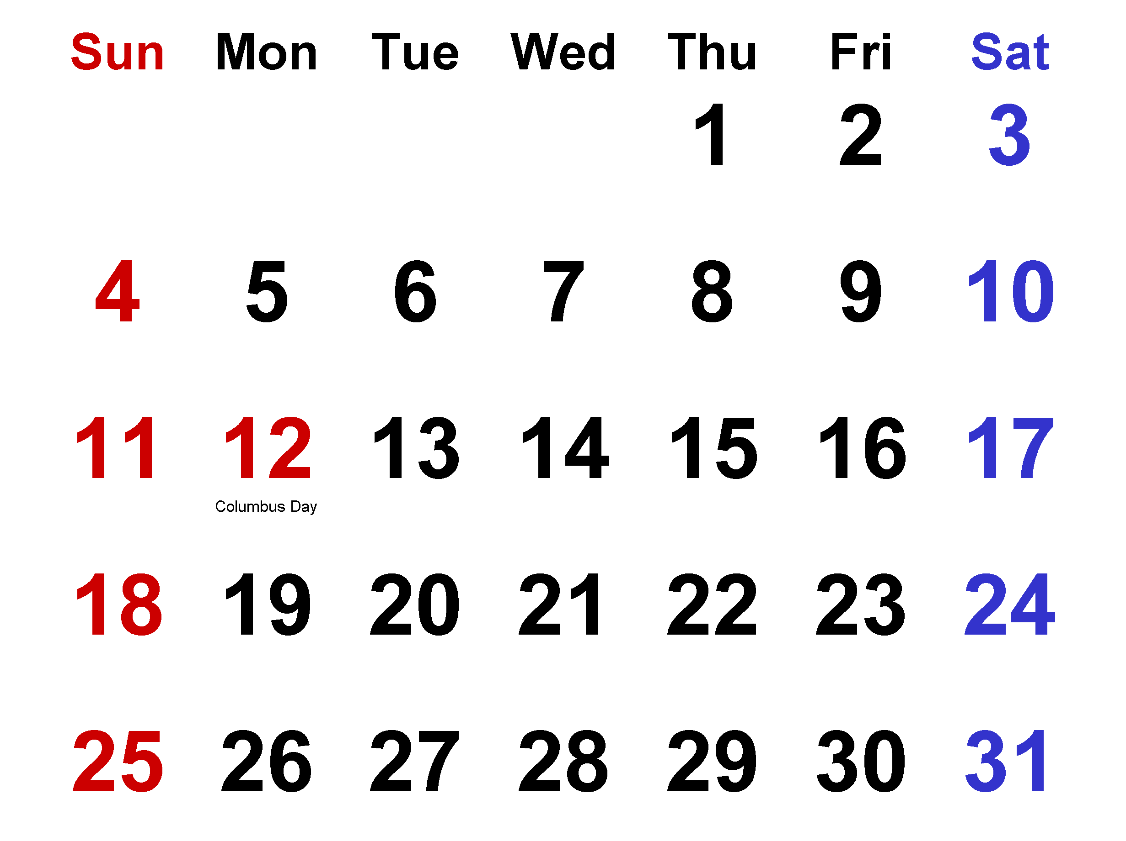
11 / MODULES 9 + 10
Practice on demand. Commit on calendar.
Content depth meets behavioural consistency.
PRACTICE QUESTION HUB
INTERVIEW SCHEDULER
October 2026
DSA Frontend Backend
Databases Behavioral
Design an LRU cache
Explain React reconciliation
When did you resolve conflict?
Instant AI explanations
Bookmarks library
UP NEXT
  Coding mock in 18h Commitment rate
  8 / 10 attended
  Export .ics
  Google
  Outlook
  Apple

Slide 13
12 / MODULE 11
Progress that feels visible
Every meaningful action compounds into identity, momentum and community standing.
PRACTICE
XP POINTS
STREAKS ×
SKILL LEVEL
BADGES
LEADERBOARD
NOVICE → JUNIOR DEV → FULL-STACK PRO → TECH LEAD → STAFF ARCHITECT
BADGES
First Step Bug Hunter System Architect Consistency King Interview Ace
GLOBAL LEADERBOARD 01 AARAV 02 PRIYA 03 YOU ↑

Slide 14
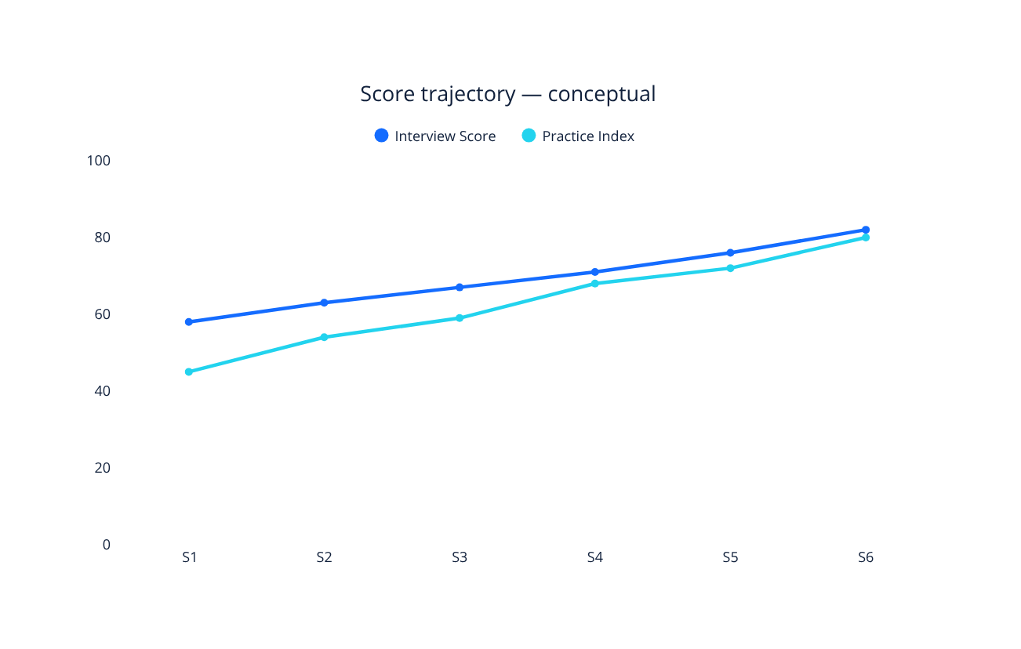
13 / MODULE 12
Performance Dashboard & Analytics
Concept interface — measures are illustrative, not research findings.
24h
PRACTISED
18
INTERVIEWS
76
AVG SCORE
Skill lens: Algorithms • System Design • Communication • Problem Solving

Slide 15
14 / MODULE 13
User Profile & Account Management
Readiness, intent and secure identity in one candidate control centre.
PROFILE
READINESS
78%
9 / 12
TARGET PREFERENCES
Company Microsoft
Role Backend Engineer
Experience Fresher
Languages Java, Python
SECURE ACCOUNT
✓ Login + registration
✓ Password hashing
✓ JWT authentication
✓ Cookie-based sessions

Slide 16
15 / ARCHITECTURE
A pragmatic full-stack AI architecture
Clear separation of interface, orchestration, intelligence and persistence.
USER
FRONTEND
React.js • JavaScript • HTML5 • CSS3
BACKEND
Node.js • Express.js
APPLICATION SERVICES
AI SERVICE
Google Gemini API
DATABASE
MongoDB
JWT authentication • Git • GitHub • VS Code

Slide 17
16 / SYNTHESIS
Innovation now. Expansion next.
An integrated environment designed around continuous improvement, not isolated utilities.
INNOVATION
FUTURE SCOPE
CONCLUSION
  AI interviews
  coding
  system design
  voice/video
  resume/ATS
  cover letters
  coaching
  learning
  practice
  scheduling
  gamification
  analytics
Advanced acoustic analysis
Deeper computer vision
More compilers
Role-specific intelligence
Multilingual support
Placement portal integration
InterviewAce AI combines preparation, technical practice, resume optimisation, career guidance and measurable continuous improvement in one AI-powered environment.

Slide 18
INTERVIEWACE AI
THANK YOU
PRACTICE. ANALYZE. IMPROVE.

